Slide 1
Literary Search
Notes:
http://upenn.summon.serialssolutions.com/#!/search?ho=t&fvf=IsScholarly,true,f%7CContentType,Journal%20Article,f%7CSubjectTerms,decision%20making,f%7CSubjectTerms,decision-making,f%7CSubjectTerms,expert%20systems,f%7CSubjectTerms,knowledge,f%7CSubjectTerms,knowledge%20management,f%7CSubjectTerms,semantics,f%7CDiscipline,medicine,f&rf=PublicationDate,2019-02-23:2020-02-23&l=en&q=%22%20expert%20system%20%22%20%20OR%20%22%20knowledge%20base%20%22%20%20OR%20%22%20inference%20engine%20%22%20%20OR%20%22%20Intelligent%20tutoring%20system%20%20%22%20%20OR%20%22%20Artificial%20intelligence%20%20%22%20%20OR%20%22%20Knowledge%20acquisition%20%22

Slide 2
Open search
Citation chasing
Research Tutorials

Slide 3
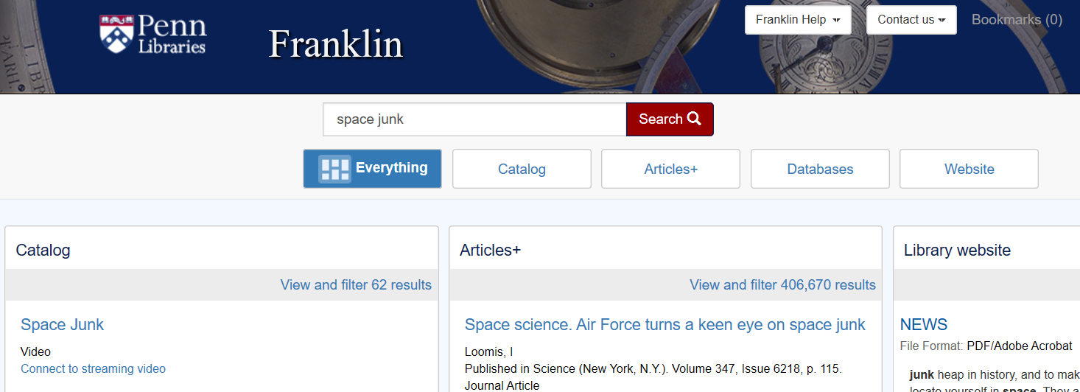
1. Open search
https://franklin.library.upenn.edu/

Slide 4
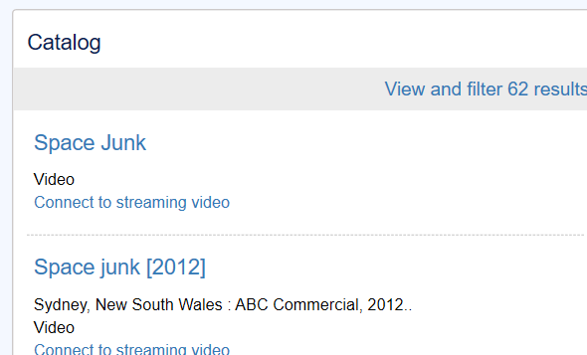
Books

Slide 5
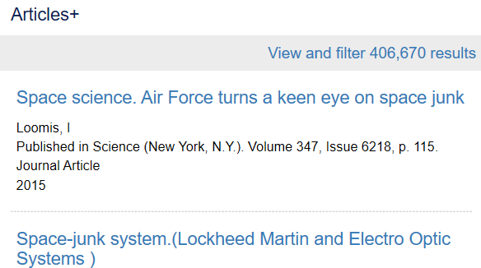
Articles
Too many!

Slide 6
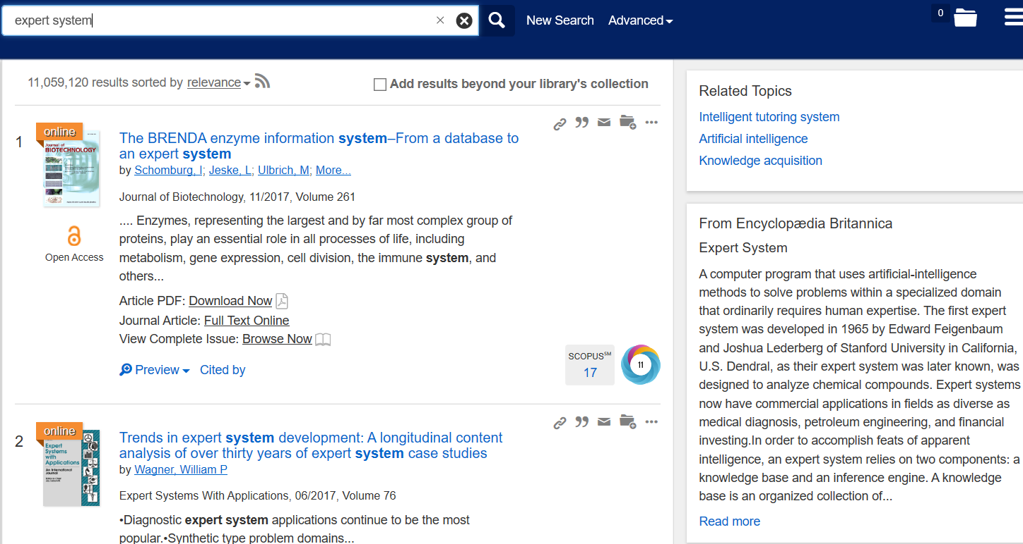
View and Filter
Additional terms: expert system, knowledge base, inference engine, Intelligent tutoring system, Artificial intelligence, Knowledge acquisition

Slide 7
Refine search using additional terms
When we want to use synonyms, we should separate them with the word OR in caps
if you're referring to a specific phrase, it's best to put quotes around that phrase so that the words in the phrase are searched together

Slide 8
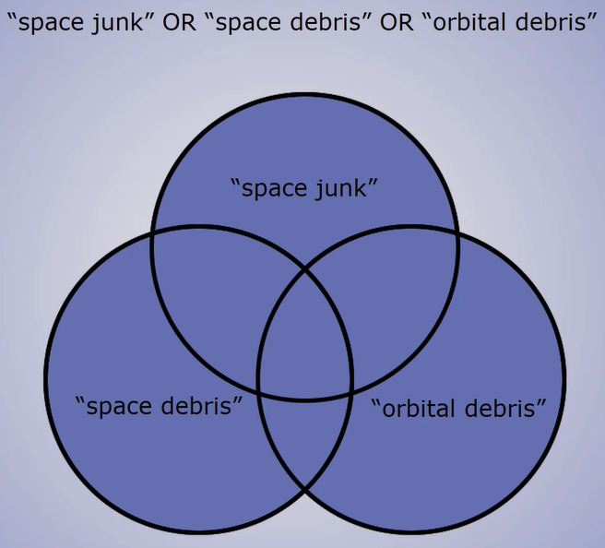
OR

Slide 9
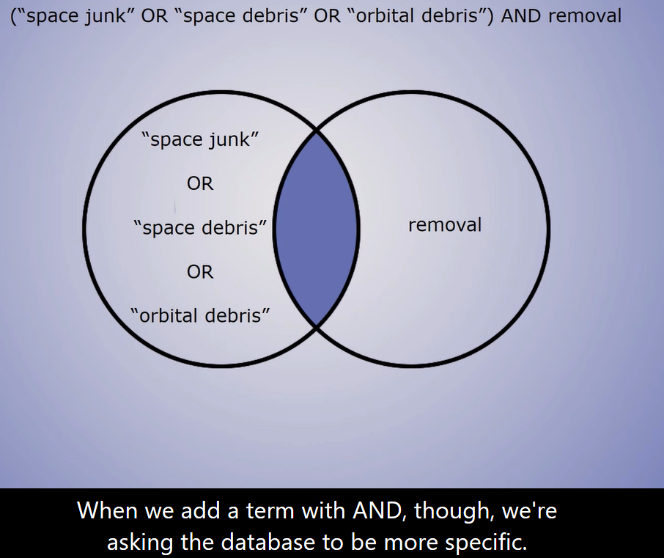
AND

Slide 10
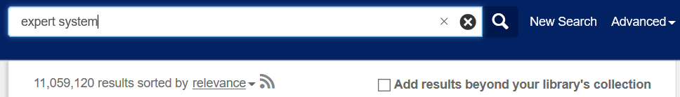
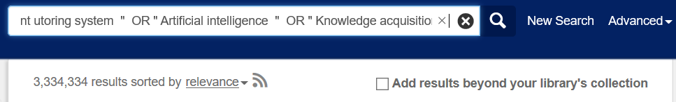
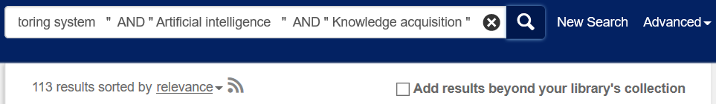
Example
VS
VS

Slide 11
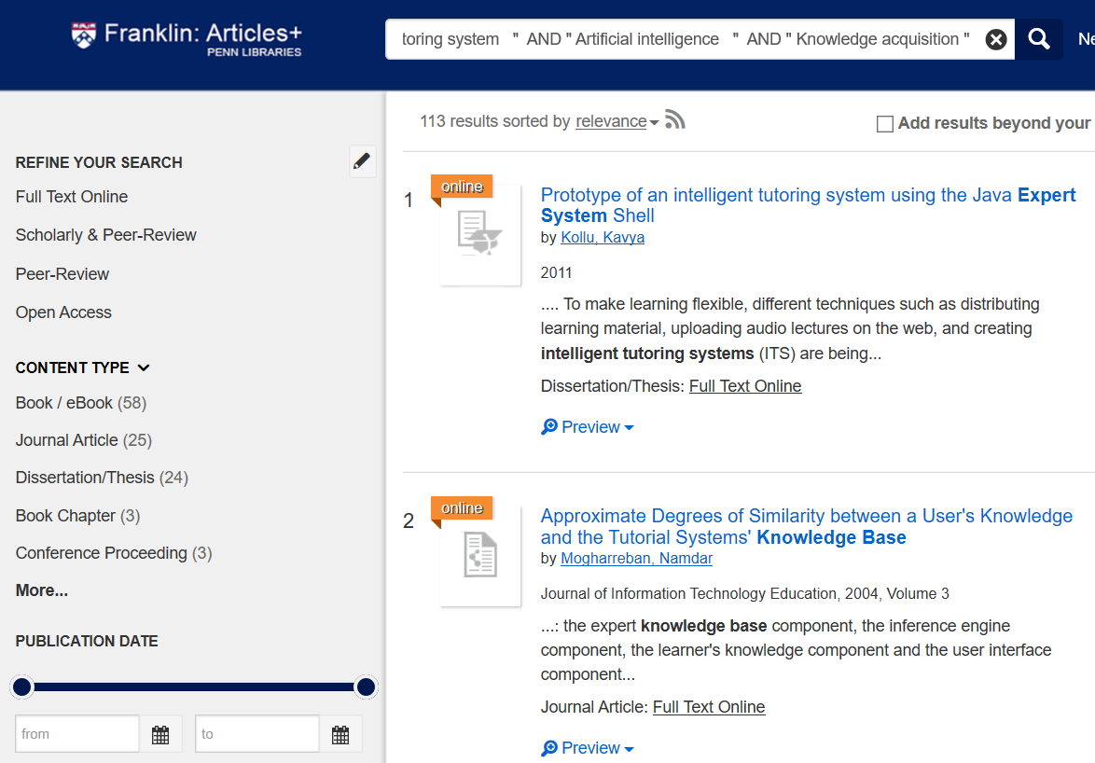
Limit to Scholarly & Peer-Review Journals

Slide 12
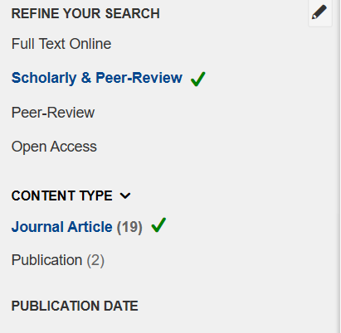
Limit to Journal Articles
In many cases, you'll want to use journal articles rather than conference proceedings

Slide 13
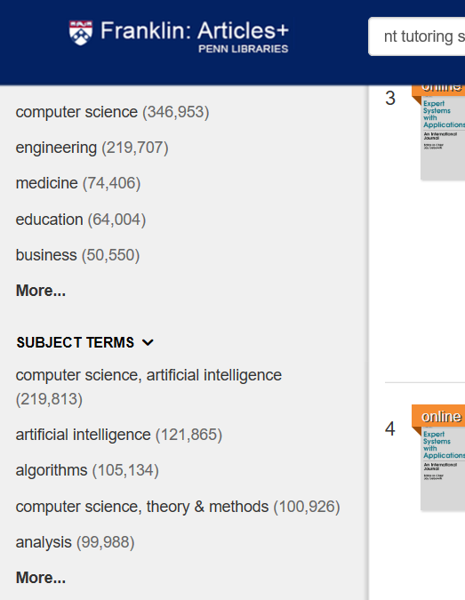
Subject Terms Filter
The subject terms filter will allow you to select the tags you want included in the results
You can differ between papers about
a term and papers that only mention
a term

Slide 14
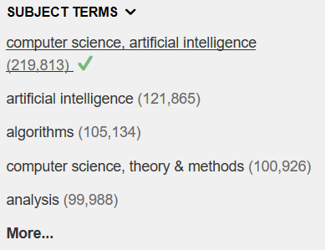
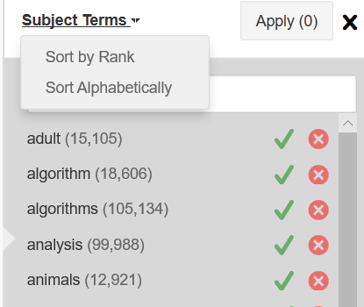
Differ between papers about a term and papers that only mention a term
1

Slide 15
Discipline and Date
Filter by discipline and date to further refine the Search

Slide 16
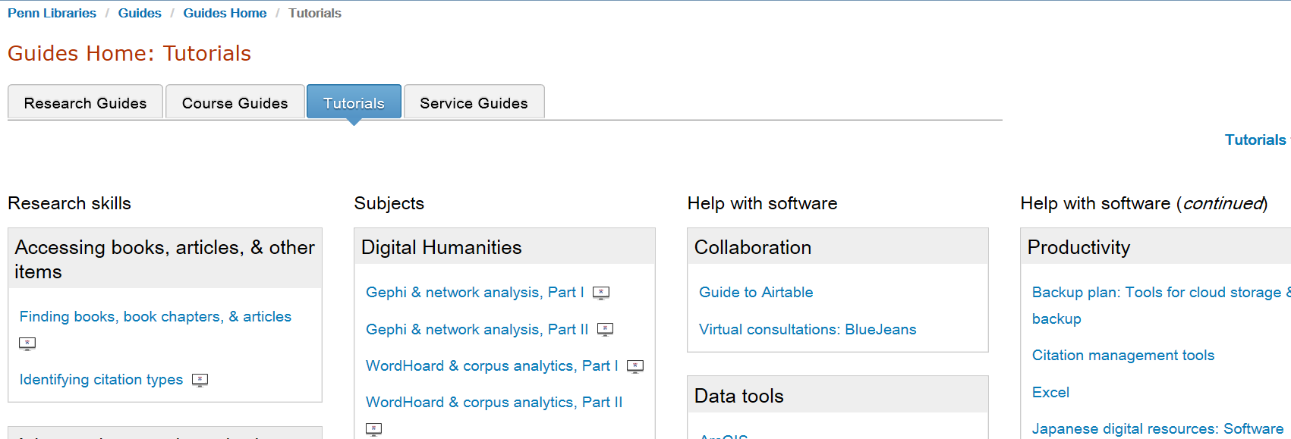
3. Research Tutorials
https://guides.library.upenn.edu/hometabs/tutorials

Slide 17
Video of Slides
https://upenn.hosted.panopto.com/Panopto/Pages/Viewer.aspx?id=d7877d16-d80b-44df-a64e-a9e501713302

Slide 18
End

